Slide 1
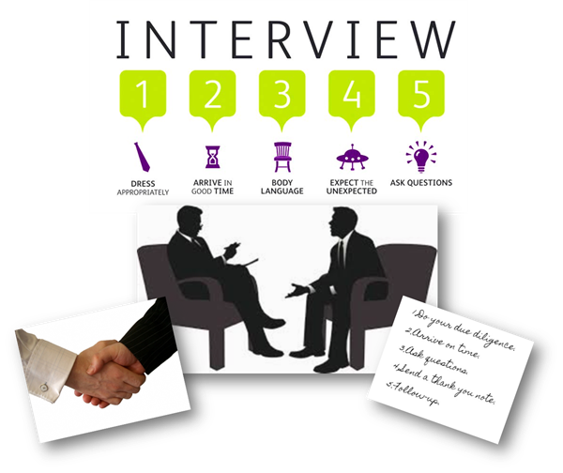
Interview Skills and Techniques
ASSISTANT PROFESSOR
Mr. Sahil Gaba

Slide 2

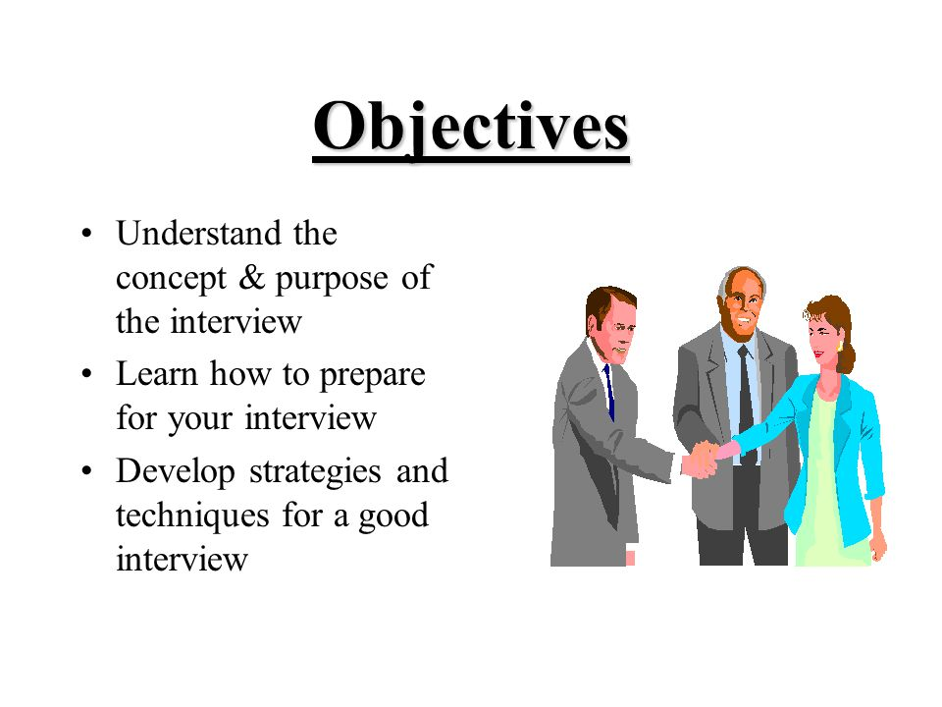
Objectives:

Slide 3

What is an Interview?
The word interview comes from Latin and middle French words meaning to “see between” or “see each other”.
Interview = A meeting with an objective
Employer’s objective is to find the best person for the job
Employer: reviews candidate’s experience and abilities
Can you do the job? (skills, abilities, qualifications)
Will you do the job? (interest, attitude & motivation)
How will you fit into the organization? (personality)

Slide 4
Facts of Interviewing
Interviews are the most widely used process for screening job applicants.
They provide the most direct information about a candidate’s background, personality, and skills.
The purpose of an interview is to receive a job offer.

Slide 5


Slide 6
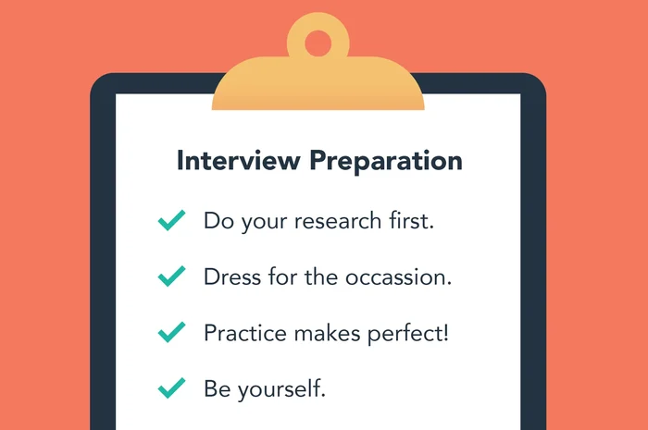
Essentials of Pre-Interview Preparation

Slide 7


Know Yourself
Employment objective and how it relates to the position and the employer
Educational background and how it relates to the position and the employer
Work experience
Abilities and skills
Do Self-Assessment
KNOW YOUR RESUME!
Always be able to give examples!

Slide 8
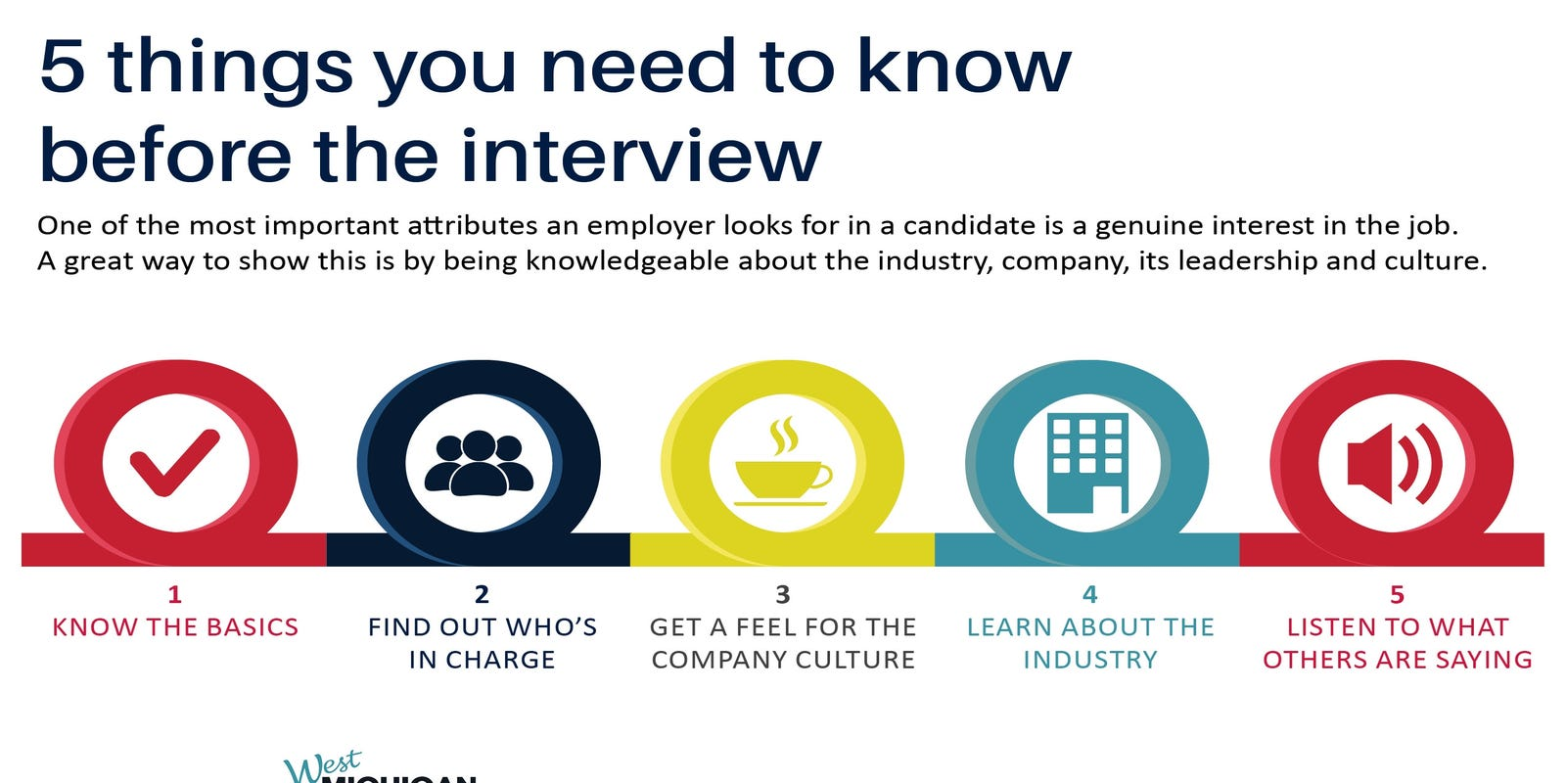
Know the Employer
Research! Research! Research!
Research the Company
Understand the company's mission, values, culture, and recent news.
Tailor your responses to align with their goals.
Understand the Job Description
Prepare specific examples of how your skills match the role.
Questions for the Interviewer
Prepare thoughtful questions to ask the interviewer.
Shows your interest and engagement.

Slide 9
Interview Preparation
Situational Knowledge
Where/when the interview takes place
Arrive 10 minutes early!
Physical Preparation
Get plenty of rest
Gather Your Documents
Dress for success
Mental Preparation
Confidence & Mindset
Practice a mock interview
Written Preparation
Take extra resumes, references, etc.
Make notes
Ask questions

Slide 10
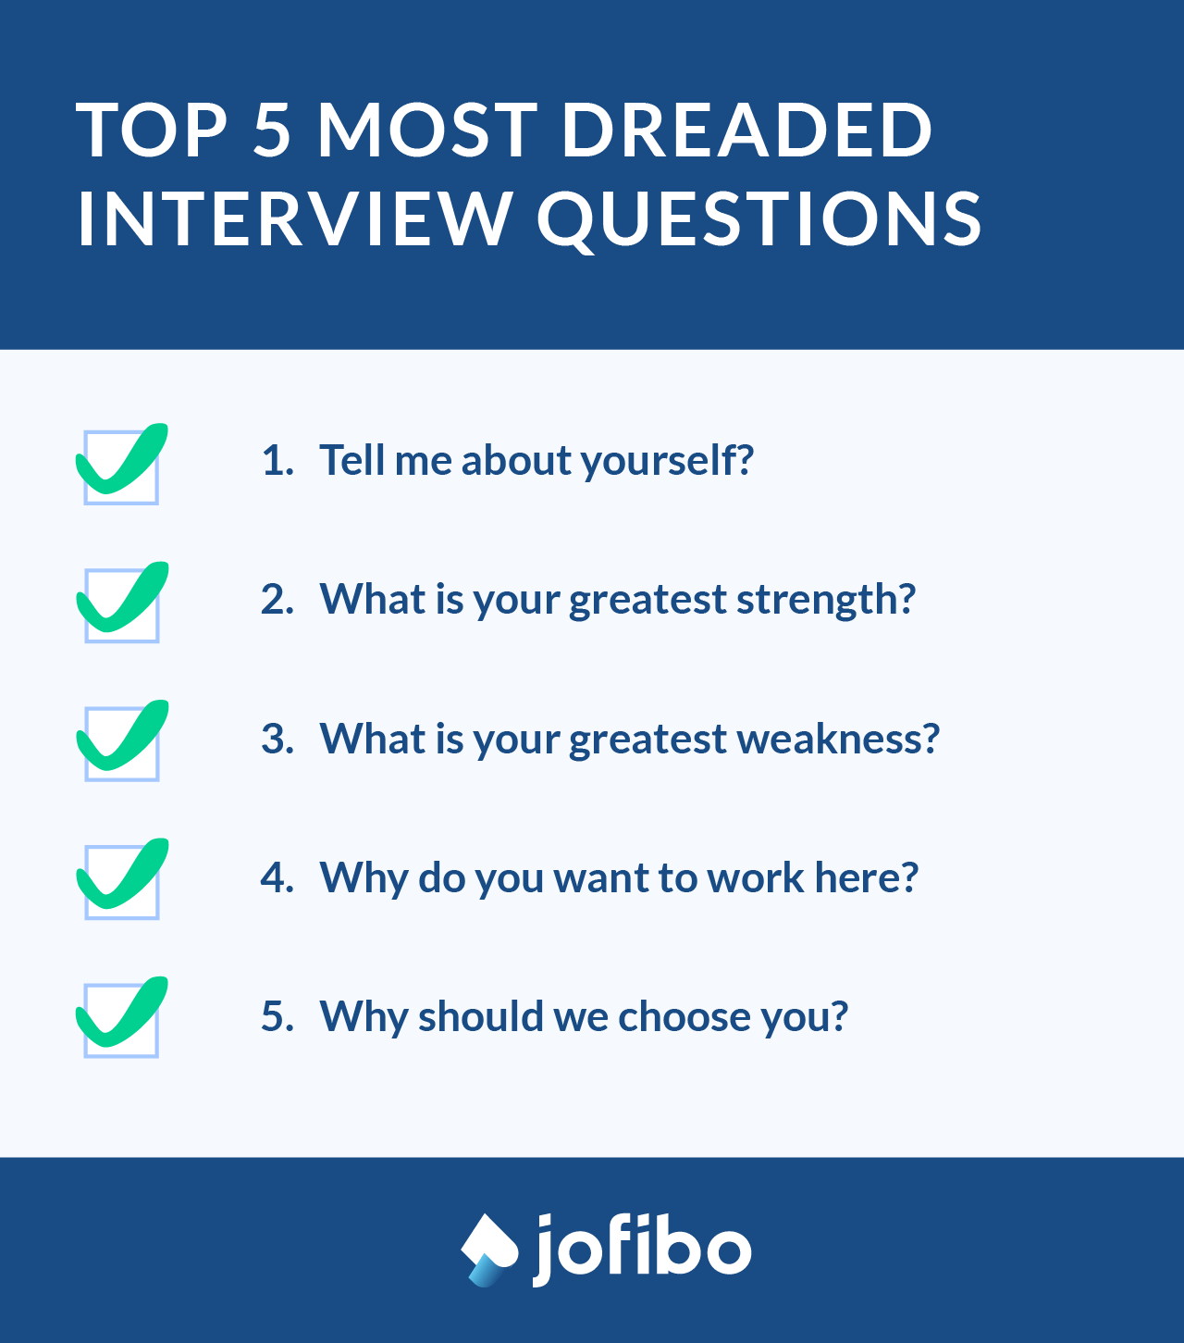
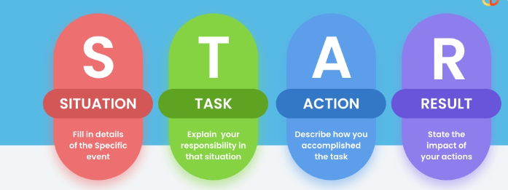
Prepare for Common Questions
Practice answers for common interview questions.
Use the STAR method (Situation, Task, Action, Result).

Slide 11
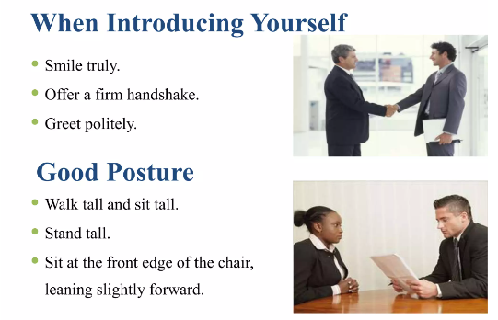
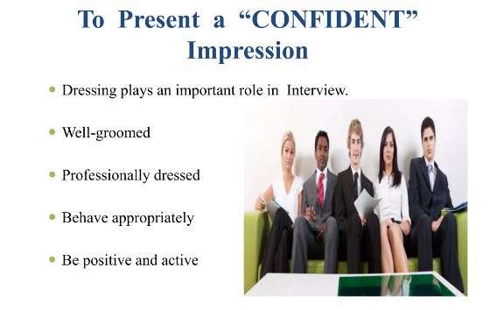
Grooming

Slide 12
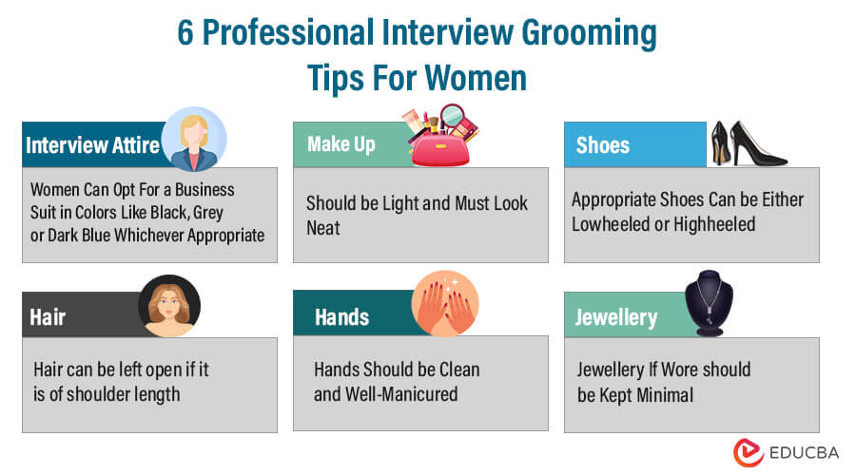

Slide 13
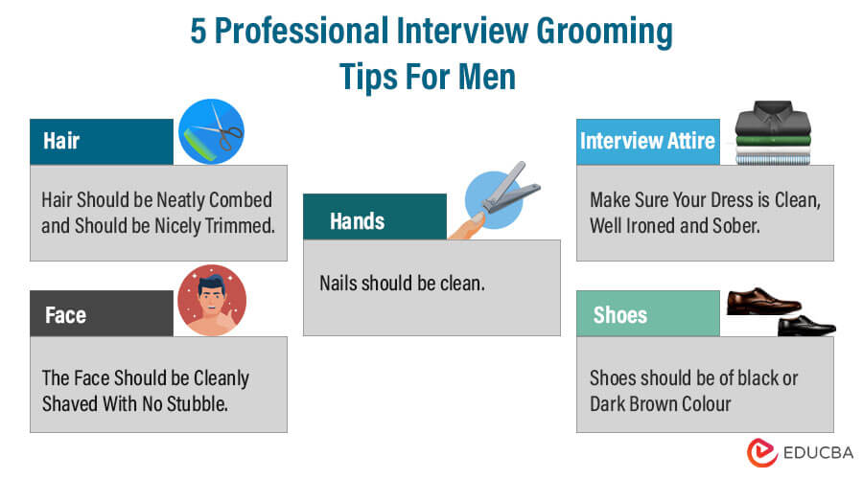

Slide 14
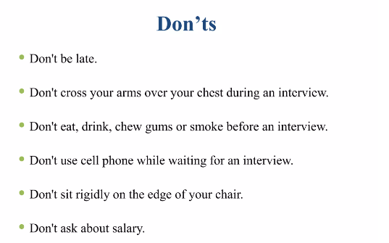

Slide 15
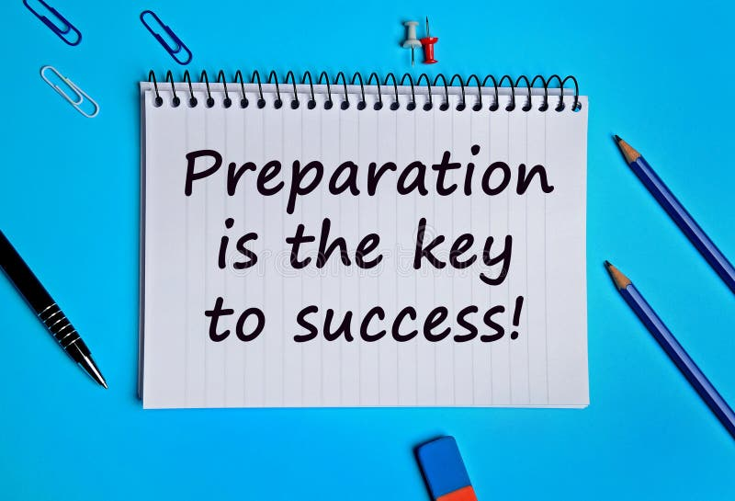
“Prepare yourself and own that interview.”

Slide 16
Types of Interviews
Basic/traditional interview
Telephone interview
Group interview
Interview during a meal or social occasion
Serial interview

Slide 17
Telephone Interviews
Prepare as thoroughly as for ‘real’ interview
Select comfortable, private, quiet place
Have copy of CV and company information
Have pen and paper at hand
Prepare for usual interview questions
Practice on phone
Record answers
Try standing
Smile and use gestures
Avoid monotones
Be yourself

Slide 18
Other Types Of Interviews
Rotating
Like one-to-one with different interviewers
Group
6-8 candidates
Group observed while discussing topic
Be aware of group interaction
Panel
2-5 interviewers, or as many as 13!!
Try to identify different roles
Respond to interviewer, include others through eye contact
May involve presentation

Slide 19
ETIQUETTES:
Online Interview
Face-to-Face Interview
Technical Setup
Background and Lighting
Dress Professionally
Eye Contact
Mute When Not Speaking
Prepared Materials
Timeliness
Professional Conduct
Punctuality
Professional Attire
Body Language
Avoid using slang or excessive jargon.
Bring multiple copies of your resume.

Slide 20

5 Stages Interview Process
Icebreaker
Greetings
First Impressions
Small talk
Personal Qualifications and Interest in the Position
Abilities, Skills, and Work Experience
Accomplishments and Activities
Goals

Slide 21

Interview Process
3. Organization and Position
Employer may test your knowledge of the company.
“Why do you want to work for this company?”
“What do you know about this department?”
Other general questions regarding the company or the job.
“What is your geographic preference?”
“Are you willing to relocate?”

Slide 22

Interview Process
Candidate Questions
Your chance to ask questions about job
“What type of on the job training do you provide?”
“What makes your company different from its competitors?”
Close and Follow-Up
Find out who makes next move
Thank the interview for their time
Evaluate your performance
Send a thank you note within 24 hours

Slide 23

STAR Technique
Situation – describe the situation, problem, or issue that you encountered.
Task – describe the tasks/responsibilities you took on to help solve the problem.
Action – discuss the steps you actually took to effect a solution.
Result – describe the positive results of your actions.

Slide 24

Tips for Successful Interviewing
Interviewing is a two-way process
Never give “yes” or “no” answers
Listen carefully and react
Use specific examples to make your case
The interview begins the minute you step onto the company lot
Be positive!

Slide 25

Tips for Successful Interviewing
Think like an employer
Don’t criticize past employers or co-workers
Be aware of illegal questions
Maintain professionalism, even if the employer does not
Be prepared for the unexpected
Be aware of body language
Be well-groomed

Slide 26
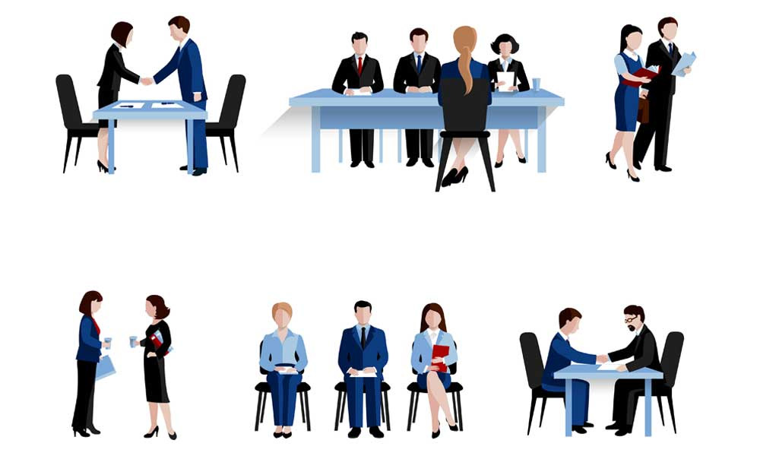
Watch the Body Language
First impression: very powerful
Allow time to relax
Dress appropriately
Entrance, introductions & handshake
Smile and make eye contact
Be aware of own movements
Watch body language of interviewer

Slide 27
Your Answers
Listen carefully, seek clarification
Illustrate answers with real examples and evidence
Be positive – constructive criticism
Keep answers specific and brief
Take time to respond
Be alert to interviewer’s body language
Speak clearly, smile and show enthusiasm
Know what you want to say, and find the opportunity

Slide 28
Qualities Employers Seek
Good all-round intelligence
Enthusiasm, commitment and motivation
Good communication skills
Team work ability
Ability to solve problems
Capacity to work hard
Initiative and self-reliance
Balanced personality

Slide 29
What creates a bad impression
Poor personal appearance
Negative attitude – evasive, using excuses
Lack of interest and enthusiasm
Lack of preparation
Poor knowledge of role
Failure to give concrete examples of skills
Over emphasis on money/rewards
Lack of career plan

Slide 30
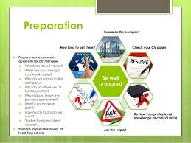

Interview preparation

Slide 31


Starting The Interview
Be sure to arrive 10 to 15 minutes prior to the start of the interview
Greet the interviewer with a firm handshake
Maintain good eye contact and posture
Make sure you are energetic and enthusiastic
Speak clearly and articulate

Slide 32
Standard Interview Questions
Would you tell me about yourself?
What is your greatest strength?
What is your greatest weakness?
Where do you see yourself in 5 years?
What about this position do you find most appealing?
Why do you want to work for our company?
Why should we hire you?

Slide 33

Ask Questions
What are your expectations of the employees in your company?
What are the strengths and weaknesses of your organization?
Describe a typical day on the job in this position.
Avoid asking questions about salary and benefits.

Slide 34
Graceful Exits
Thank you for your time
I appreciate it
I will be looking forward to hearing from you

Slide 35

After the Interview
Evaluate your performance
Send a thank-you note within 24 hours
Keep records of important dates and details for the follow-up

Slide 36

ANY QUESTIONS?

Slide 37


